Slide 1
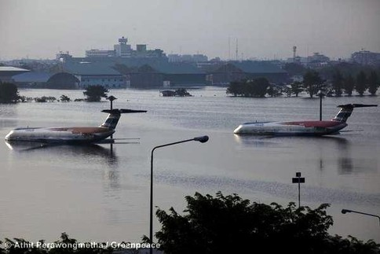
Climate Adaptation
N-ALM 15-16 November 2016, Helsinki Vantaa

Slide 2
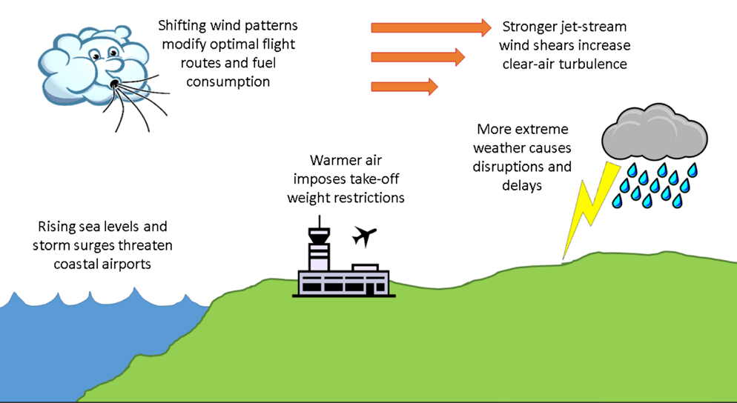
Challenges of climate change

Slide 3
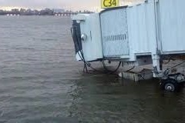
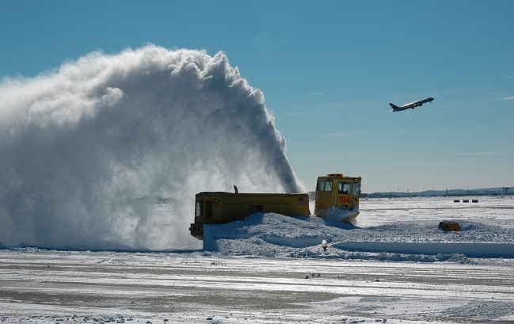
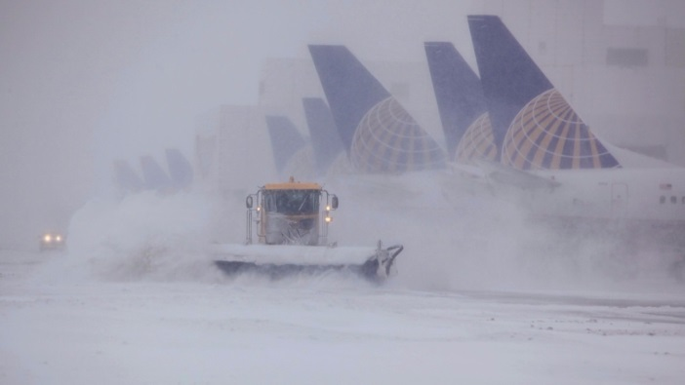
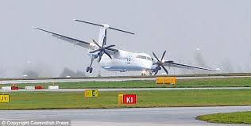
Climate adaptation in ICAO
Not strictly an environmental task BUT
CAEP has incorporated it into its work programme
Develop guidance on building of resilience (WG2 Airport Planning Manual)
Eurocontrol involved

Slide 4
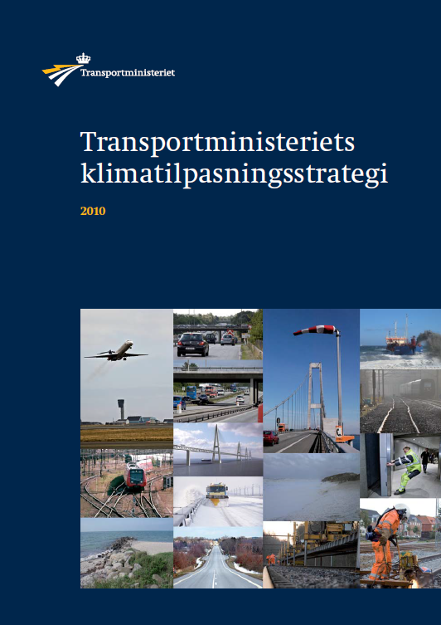
Denmark – work on climate adaptation
Climate adaptation forum in Transport ministry
Railways, roads, metro, ports, airports
Strategy for climate adaptation in 2010
Challenges for airports: increasing sea levels
more powerful storms
Questionnaire to major airports
Identify major challenges and mitigation work
Copenhagen Airport: National importance, close to sea, low level

